Slide 1


CZ2006 SWE NTU TIMETABLE PLANNER
Team Digist
Notes:
Morning, Prof Li, and Christopher. Our team, Digist, has decided to build an NTU-specific timetable-planning application to complement STARS.
We hope that through our project, we can make timetable planning an intuitive and collaborative experience for every student here

Slide 2

TABLE OF CONTENTS
1
2
3
PROBLEM
SYSTEM ARCHITECTURE
CORE IMPLEMENTATION
4
5
6
EXPRESS INTEREST
VISUAL PLANNER
LIVE DEMO
Notes:
So, first up, I’ll be walking you through the problems that we face with the current STARS planner, and the solutions that we have for these problems
Next, Yi Shen will bring you through our overall system architecture, followed by Austen who will explain our core implementation classes
Thereafter, Sandra and Sunny will bring you through 2 of our more unique features, and the design patterns that went into their implementation
And finally, Yu Chen will give you a live demo of our product

Slide 3

PROBLEM 1
TOO MANY COMBINATIONS
Exponential growth with # of courses
Only a tiny proportion is valid
No option for “free days”
Notes:
[click] So, the first problem that we face is that there’re simply too many combinations for us to try
Let’s consider this – on average, we take 6 courses a semester. For each course, there’re about 10 possible indexes, hence giving us about a million combinations to experiment with
[click] Of course, not all of them are valid.
[click] And, like many of us, if you want a free day, more time needs to go into the planning process

Slide 4
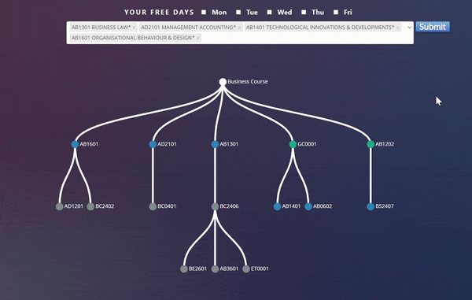
SOLUTION 1
Allow specifying of “free days”
Cycle through all valid combinations
Notes:
To overcome this, we introduced 2 simple, but helpful features to save time for our users
[click] Firstly, we let them specify the days that they don’t wish to have lessons, and if you notice in the GIF, Tuesdays and Thursdays are free of lessons
[click] Secondly, we give them all valid combinations of timetables that they can easily cycle through with the previous and next buttons on the top right of our interface

Slide 5

PROBLEM 2
CHANGING INDEXES
Alternatives are explored one by one
No elimination of clashing indexes
Index swapping is slow and unintuitive
Notes:
Now, if you’ve tried changing indexes in STARS, you’ll know how painful it can be
[click] Students have to loop through every single index of that course to find a valid, non-clashing index
[click] The worst part is that clashing indexes are not automatically eliminated from the dropdown menu
[click] Now, that is simply slow and unintuitive for users

Slide 6
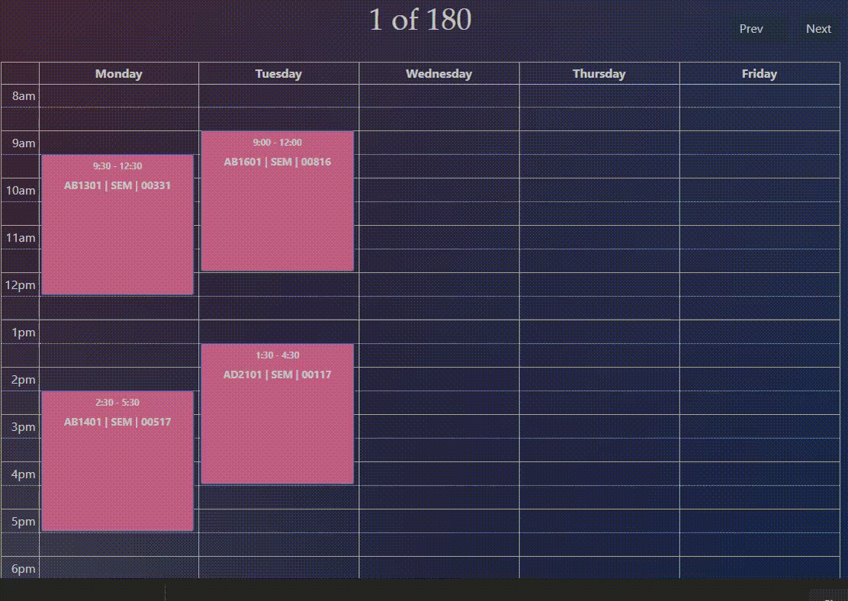

SOLUTION 2
View all alternatives on click
Swap indexes with one click
Facilitates timetable fine-tuning
Notes:
So, to make this process more fluid, [click] viewing [click] and swapping to an alternative index is done in only 2 clicks
[click] With a visual click-to-swap interface, fine-tuning an existing timetable can be done much more quickly
As seen in the GIF, a bird’s eye view of the alternative indexes, in grey, are provided, making index swaps visually intuitive

Slide 7

PROBLEM 3
UNKNOWN WAITLIST
Highly-competitive and popular indexes
No knowledge on demand vs vacancies
Unable to strategize based on demand
Notes:
Right, with the basic features completed, our next 2 features were designed to promote collaboration to the timetable planning experience in NTU
[click] Now, this process has always been adversarial – that’s why we call it Star Wars
[click] A key reason for this is, students are unable to anticipate the demand for a particular index, [click] and hence cannot strategize according to this demand

Slide 8
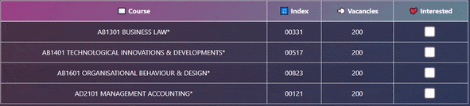
SOLUTION 3
Express/view interest for any index
Higher chance of a successful bid
Reduce over-subscription chance
Notes:
To solve this, we provide demand information of every index, through the Express Interest feature
[click] Students can indicate their interest for a particular index, and this is then propagated to a backend data store
[click] This not only increases the odds of a successful bid, [click] it reduces the chances of oversubscription for an index

Slide 9

PROBLEM 4
POOR VISIBILITY INTO STUDY PROGRESSION
Must refer to curriculum when planning
Lack of personalized recommendations
Notes:
Finally, on to our last and final problem
[click] Often, during timetable planning, we must refer back to our prescribed curriculum and degree audit
[click] So, wouldn’t it be nice to have the system recommend me courses based on the pre-requisites that I’ve cleared?
Well, we have that covered as well!

Slide 10
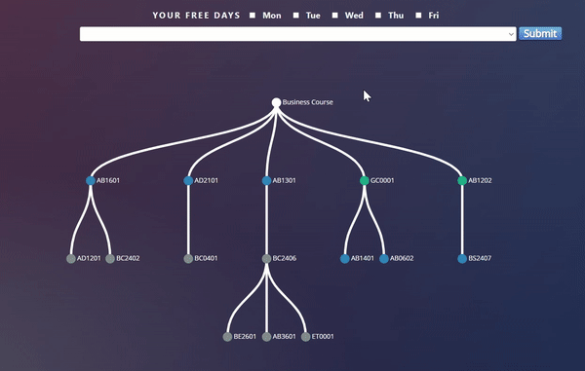
SOLUTION 4
Personalized recommendations based on cleared pre-requisites
Bird’s eye-view of their academic progress
Notes:
What you see here is a graphical representation of the modules, sorted by study year
[click] There is a clear indication of the user’s cleared, locked, and available modules in the current semester
[click] It is effectively a personalized bird’s eye-view of their current academic progress, which can provide them with a sense of achievement as well

Slide 11
FEATURE RECAP
PLANNING WITH FREE DAYS
QUICK INDEX SWAP
EXPRESS INTEREST
PROGRESSION TREE
Notes:
All right, just to do a quick recap of our product, we have introduced the following 4 improvements in our planner
[click] First, allowing users to specify their free days
[click] Two, single-click index swapping
[click] Three, expressing interest in a particular index
[click] And finally, a bird’s eye view of their current academic progress
With that, Yi Shen will now bring you through the high-level design of our application, through an architecture diagram

Slide 12
TABLE OF CONTENTS
2
3
PROBLEM
SYSTEM ARCHITECTURE
CORE IMPLEMENTATION
4
5
6
EXPRESS INTEREST
VISUAL PLANNER
LIVE DEMO
Notes:
Thank you Wei Lun, for the next part of our presentation I will be talking about the system architecture of our application
[Next Page]

Slide 13

DESIGN – MTV
BACKEND ARCHITECTURE
Django REST framework
Model – User / Course Data
View – Controllers
Template – Frontend HTML/JS
Notes:
At the very core of our application is the Django REST framework which is a powerful and flexible toolkit for building web APIs.
Django uses a MVT, Model Template View pattern which is similar to the Model View Controller pattern which we are familiar with
The Model is where the logical file structure of the project, and handles data between our databases and the view
The View formats the data from the model and handles the business logic
The Template is the data presenter and handles presentation logic and how it should be displayed to the user [Next Page]

Slide 14
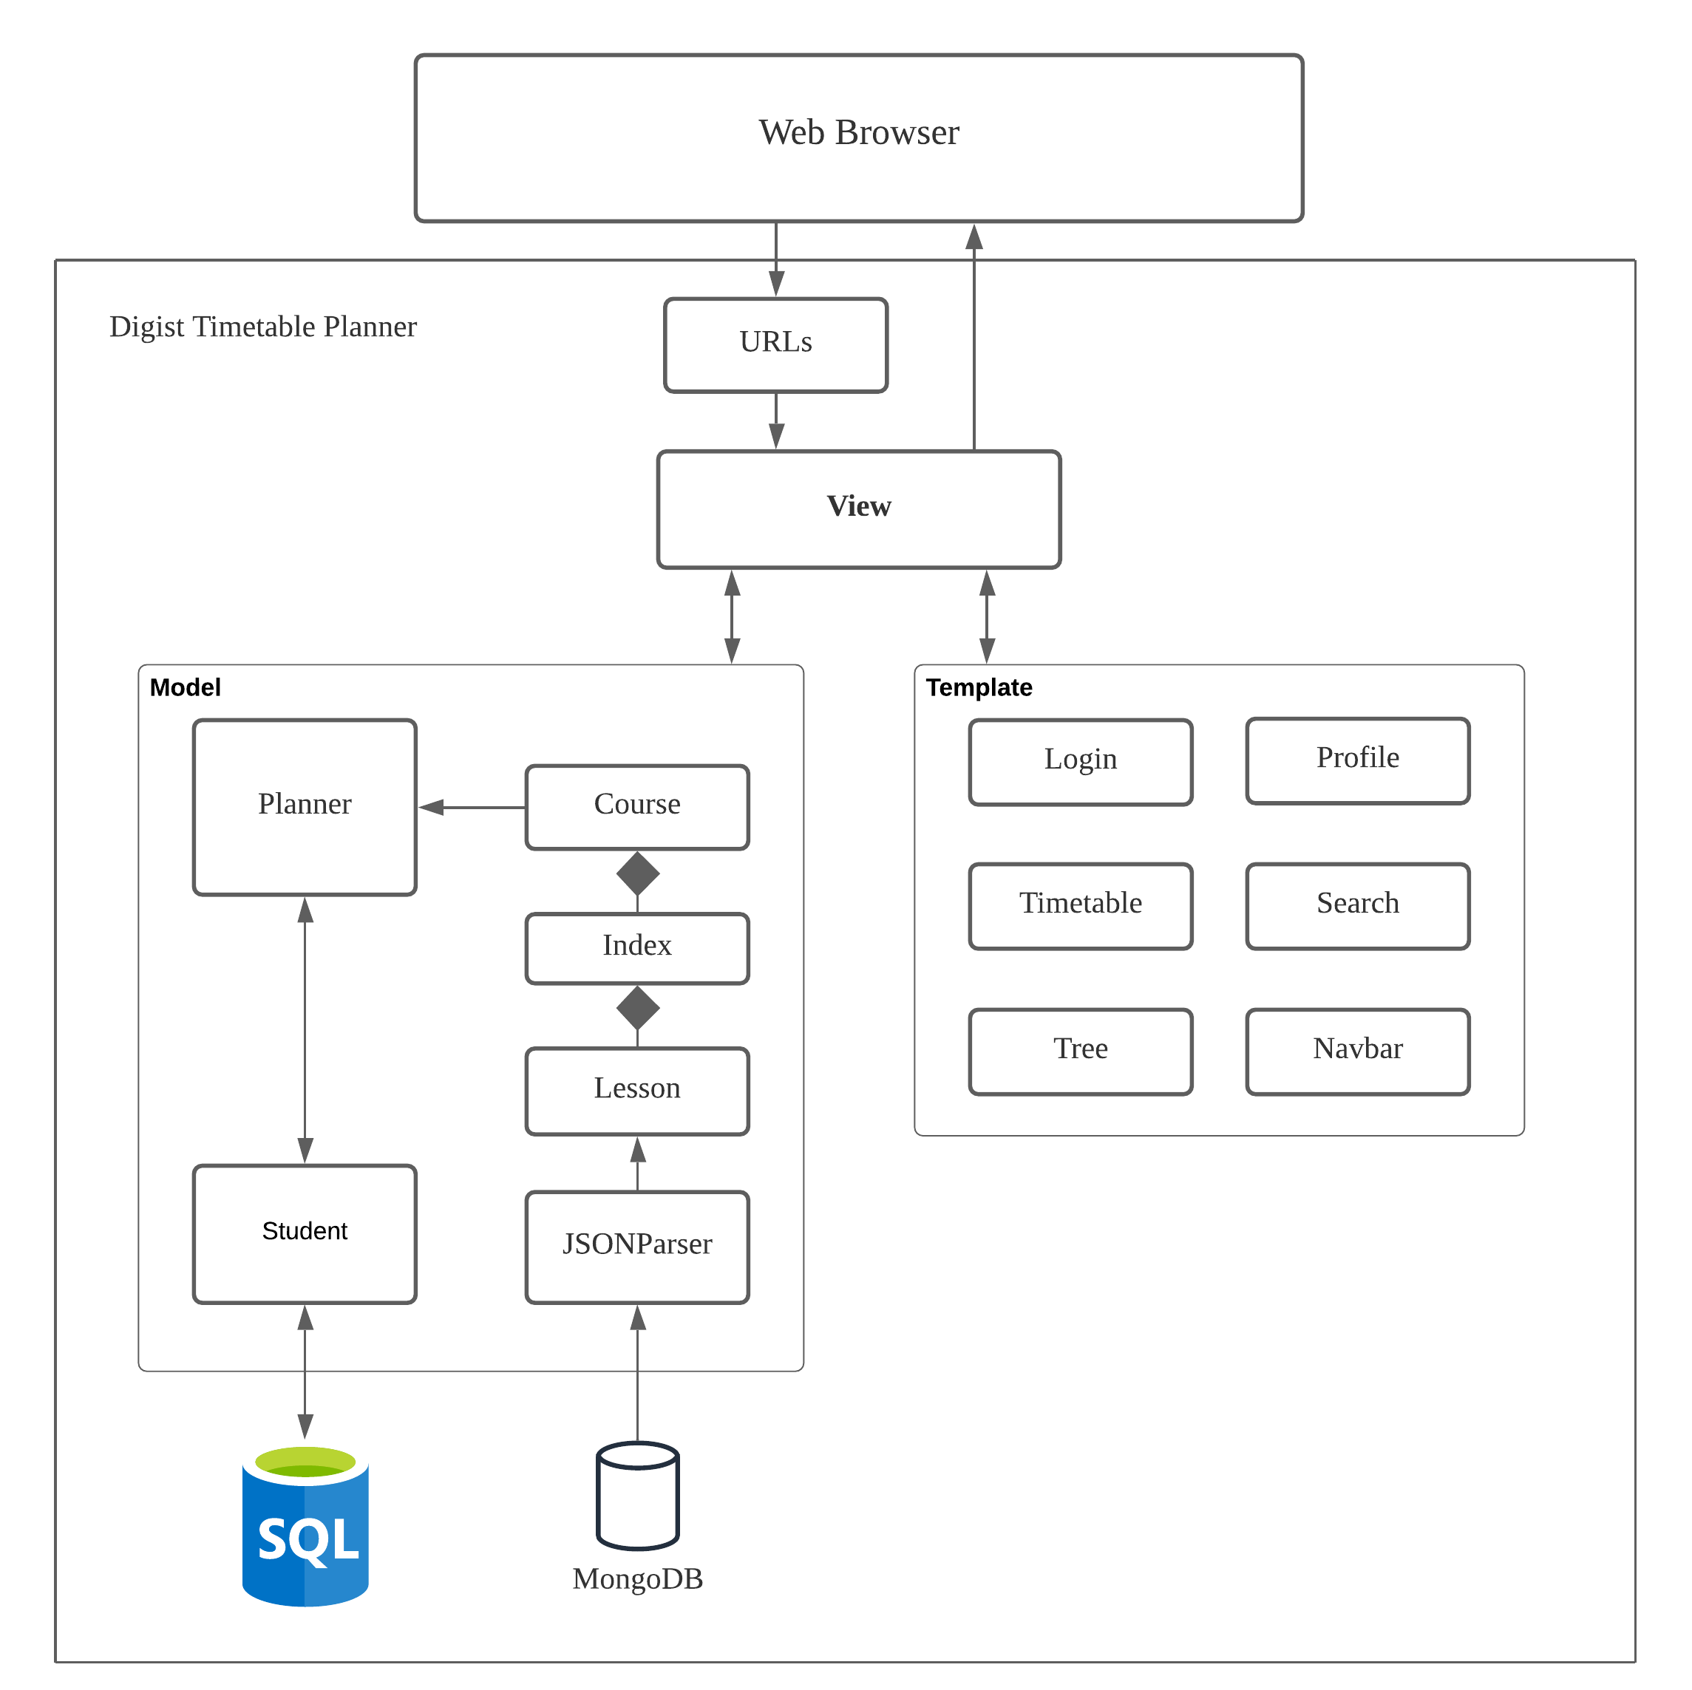
Control Flow
BACKEND ARCHITECTURE
User requests URL
Django checks if URL exists
If URL is mapped, a view is called that renders a template
Template sent back as a response
Notes:
The control flow in Django goes as follows: The user requests a URL
Django will check if the URL is mapped
If there is a match, a view is called
The view will execute any business logic and fetch required data from the models
The view will then place the data in the respective template and then display it to the user [Next Page]

Slide 15

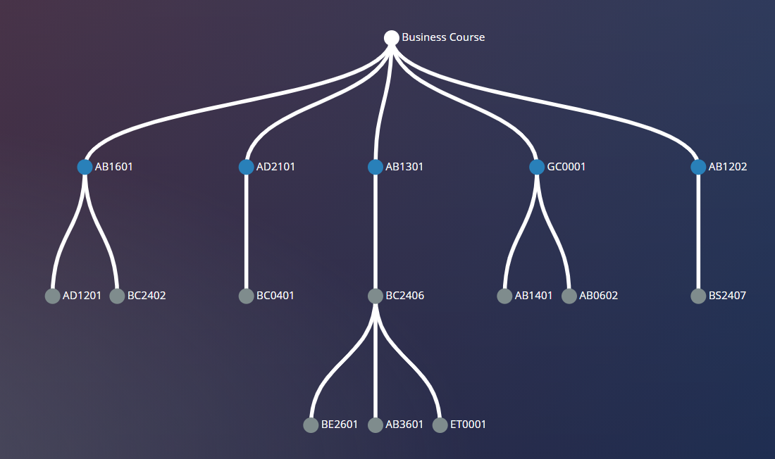
D3
JavaScript Library
Dynamic, interactive data visualization for the web
Used for drawing the graph of Courses
Notes:
Here are the libraries we used to in our application
D3, a library for visualizing data
This library allows us to plot the graph of the users courses that they are able to take [Next Page]

Slide 16

FullCalendar
JavaScript Library
Powerful and lightweight
Customizable
Supports events like onClick
Notes:
FullCalendar
A calendar library that supports interactivity like onClick which is crucial to our implementation

Slide 17


Databases
BACKEND ARCHITECTURE
SQLite for the student database
MongoDB for course information
Notes:
For our databases we used SQLite to store our student information and mongoDB for course information [Next Page]

Slide 18

Further Improvements
SERVER-SIDE CACHING
Backtracking is expensive
Course combinations are limited
Suggestion : Redis for scalable caching
Notes:
With the amount of courses and the available combinations being extremely large, some further improvements that we can make is by using server side caching
To store the current course combinations for further use
We can use Redis for scalable caching if we were to further expand on our project
Next ill pass on to Austen where he will explain more on our base classes [Next Page]

Slide 19
TABLE OF CONTENTS
2
3
PROBLEM
SYSTEM ARCHITECTURE
CORE IMPLEMENTATION
4
5
6
EXPRESS INTEREST
VISUAL PLANNER
LIVE DEMO

Slide 20
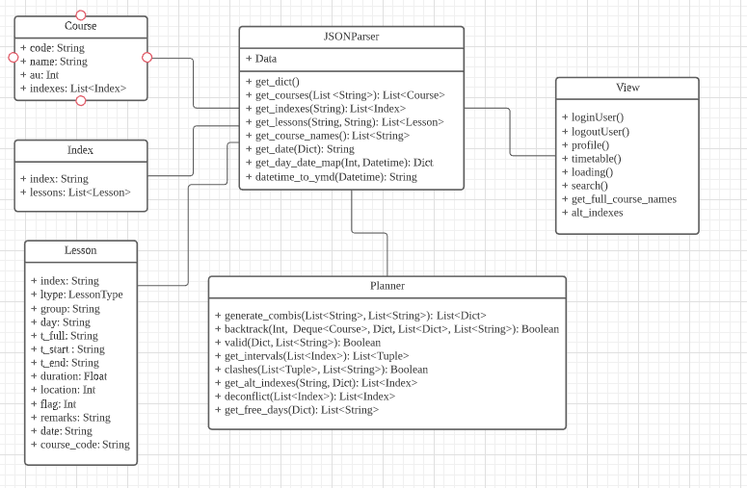

Class Diagram
JSON Parser retrieves data from a JSON file
Planner class will generate combinations and get alternative indexes
Notes:
For the class diagram of our time table planner, we have several classes. One of the main class will be JSONParser which is going to retrieve all the data from the JSON file containing all information of the courses/indexes etc. Planner will then make use of this information from the json parser to generate different non clashing combinations and also getting alternative indexes when students click on a certain course. Classes such as lesson are used as a method of parsing inputs such as date/time from the json file . View will then direct students to the correct pages.

Slide 21
TABLE OF CONTENTS
2
3
PROBLEM
SYSTEM ARCHITECTURE
CORE IMPLEMENTATION
4
5
6
EXPRESS INTEREST
VISUAL PLANNER
LIVE DEMO

Slide 22
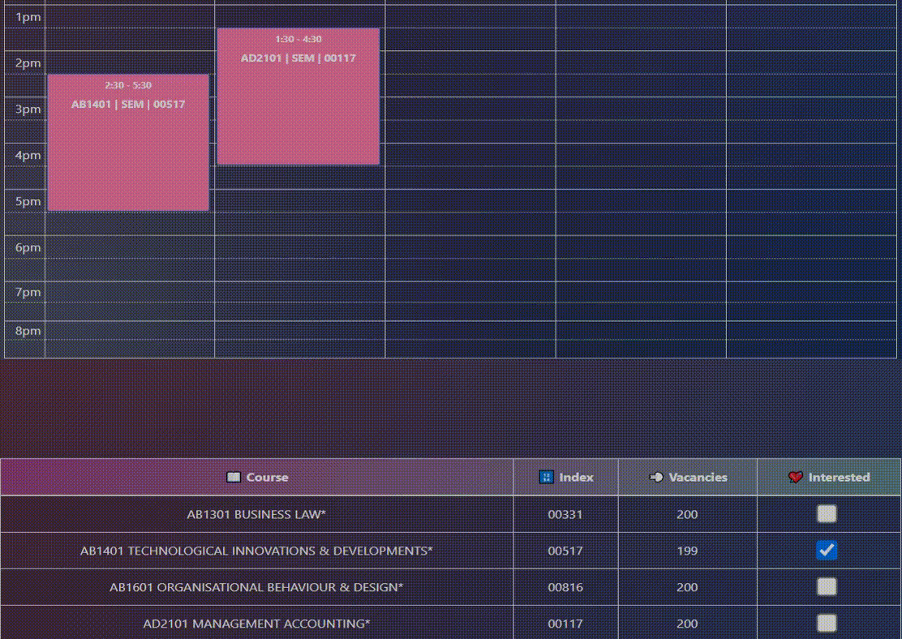
DESIGN – PUB / SUB
INTEREST EXPRESSION
Rows are subscribers
Timetable entries are publishers
Extended Entry’s onClickHandler
Updates index, vacancies, and interest
Notes:
One of our unique features, as mentioned earlier by Wei Lun, is letting users express their interest in a particular index
During its implementation, we found the publisher-subscriber pattern to be really useful
If we look at the GIF, each time an index swap happens, the changes propagate to the table below
So, on a high level, [click] we have the table as a subscriber. Or more specifically, every row in the table is a subscriber
Next, [click] every timetable entry that you see up here is a publisher
Each time an index swap occurs, [click] the timetable entry is going to broadcast this change to the correct row below, via the onClickHandler
[click] This way, the index, vacancies, and interest for every index can be updated in real-time and displayed to our users

Slide 23
1
1..*
TimetableEntry
- interestTableRows[]
+ register(interestTableRow)
+ unregister(interestTableRow)
+ notify(index, newIndex)
Row
- index
- vacancy
- interest
+ updateIndex(newIndex)
+ updateVacancy(newIndex)
+ updateInterested(newIndex)
Notes:
All right, diving into the technical implementation details, we have made each row subscribe to its corresponding timetable entry
For instance, the row for AB1401 listens for any change to its timetable entry
In other words, the Push notification mechanism is used here, where changes are pushed from timetable entry to row
Now, upon an index swap, the onClickListener for the clicked entry will be triggered, [click] followed by the notify() function, which will then call upon [click] these 3 functions in the corresponding row to update the index, vacancies, and interested flag
And that sums up how we designed and implemented the pub-sub pattern in this simple feature of expressing interest

Slide 24
TABLE OF CONTENTS
2
3
PROBLEM
SYSTEM ARCHITECTURE
CORE IMPLEMENTATION
4
5
6
EXPRESS INTEREST
VISUAL PLANNER
LIVE DEMO

Slide 25
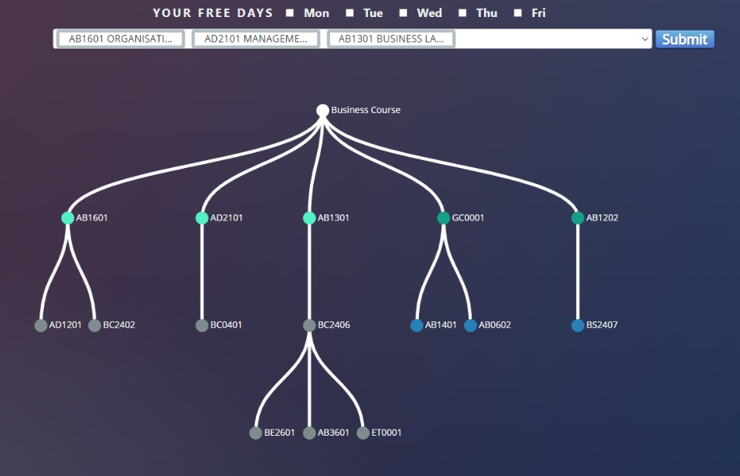
DESIGN - FACADE
PROGRESSION TREE
Uses 3rd party JavaScript library
Able to modify nodes and colours
Uses SVG properties
Notes:
The Facade Pattern provides a simplified interface to a larger body of code.
It typically involves a single wrapper class that contains a set of variables and methods required by the client that access the full body of code and hide the implementation details in order to reduce the client perceived complexity of the code.
We are using a 3rd party js lib, d3 which enables us to draw the graph as well as modify nodes and colors. The graph itself is actually a dynamically generated SVG where it will change based on different users course as well as what they have cleared so far

Slide 26
TABLE OF CONTENTS
2
3
PROBLEM
SYSTEM ARCHITECTURE
CORE IMPLEMENTATION
4
5
6
EXPRESS INTEREST
VISUAL PLANNER
LIVE DEMO

Slide 27
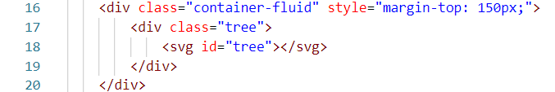
DESIGN - FACADE
PROGRESSION TREE
Able to hide complicated implementation

Slide 28






MEET THE TEAM
Austen
Sandra
Sunny
Y2 CS
Y2 CS
Y2 CS
Wei Lun
Yi Shen
Yu Chen
Y2 BCG
Y2 CS
Y2 CS

